Slide 1
MVP to MVVM
An Introduction to
Model-View-ViewModel
Jason Lepp
Mo Khan
Craig Anderson

Slide 2
Outline
Reviewing Model-View-Presenter
Sample App
Introduction to Model-View-ViewModel
What is it? Why use it?
Binding/DataContext
Communicating Changes to the View
User Interaction
Difficulties with Model-View-ViewModel
What are they?
How do we solve them?
Summary
Questions
Notes:
Communicating Changes
INotifyPropertyChanged
INotifyCollectionChanged (ObservableCollection<T>)
User Interaction
ICommand
IDataErrorInfo
IValueConverter

Slide 3
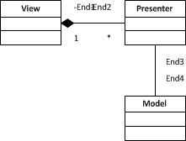
Reviewing Model-View-Presenter
Two Flavours
Supervising Controller
Passive View
There is a lot of ____ between the View and Presenter
Plumbing to be done
Chatter back and forth
Presenter has reference to View to tell it what to do
Presenter interacts with the Model to complete behaviours
Notes:
Ask audience about what they use? Winforms? Presentation patterns?
MVP -> Supervising Controller: “Factor the UI into a view and controller where the view handles simple mapping to the underlying model and the controller handles input response and complex view logic.”
MVP -> Passive View: “A screen and components with all application specific behavior extracted into a controller so that the widgets have their state controlled entirely by controller.”
Next -> overview of the app

Slide 4
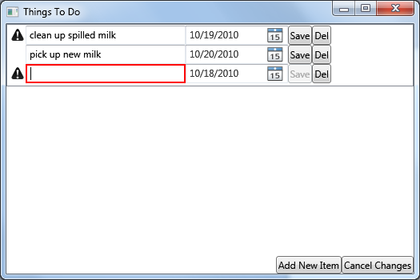
Things To Do – Sample App
Notes:
Overview of application.
Add/remove item
Validation
Notifications
Next -> Show the MVP code.

Slide 5
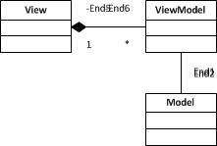
Introduction to Model-View-ViewModel
Another Presentation Pattern
ViewModel knows nothing of the View
ViewModel is attached to the View
Behaviour is executed through commands which interact with the Model
Notes:
MVVM: is a specialization of the more general Presentation Model pattern, tailor made for WPF and Silverlight.
View knows which properties it must bind to.
ViewModel communicates updates to the View via events.

Slide 6
Why Use Model-View-ViewModel?
Built-in plumbing via WPF features
Less Code
Looser Coupling
Focus on design without affecting behaviour
Maintainability
Simplicity

Slide 7
Binding/DataContext
DataContext
Every control has one
It is the ViewModel that is being bound to
Binding
Used to bind properties on a control to properties on a DataContext (ViewModel)
Notes:
Code Example
Show the MainWindow.xaml.cs where we assign a ViewModel to the DataContext.
Show the MainWindow.xaml where we bind to properties on the target ViewModel.
Show the MainWindowViewModel to show the properties that the view is bound to.

Slide 8
Communicating Changes to the View
INotifyPropertyChanged
Used to tell the view that a specific property has changed.
INotifyCollectionChanged (ObservableCollection<T>)
Used to tell the view that the items in the collection have changed.
Notes:
Show them what happens when we change the ObservableCollection to a List.
Show them what happens when we do not raise a property changed for the warning icon.
Calling the property changed event handler is not pretty, but we will show you a way to deal with it.

Slide 9
User Interaction
ICommand – Consists of two things:
The action to perform
A specification for when that action can be performed
IDataErrorInfo
Used to provide validation notifications to the View
Notes:
User Interaction
IValueConverter
Go over the SaveCommand, DeleteCommand.
Go over the Description and DueDate validations.

Slide 10
Difficulties with Model-View-ViewModel
Bindings are strings (XAML vs. C#)
Some controls don’t bind well
INotifyPropertyChanged events are published as strings
Synchronizer<T>
XAML Oddities
Notes:
Show them the synchronizer.
OpenFileDialog is hard to bind a view model too.
XAML oddities
Things like stretching controls (horizontal alignment/horizontal content alignment)
DockPanel vs. StackPanel.
Stretching

Slide 11
Summary

Slide 12
Questions?

Slide 13

Contact Us
Jason Lepp
jlepp@arcresources.com
Mo Khan
mkhan@arcresources.com
Craig Anderson
canderson@arcresources.com

